Slide 1


Layman to Intermediate Python
Mrinal Vashisth
PhD Year 2, Computational Pyschometrics, TSU, RF
M.Sc. Human Development: Genetics, Neuroscience and Psychology, TSU, RF
M.S. Applied Mathematics and Information Technology (Systems Biology and Bioinformatics), ITMO, RF
B.Tec. Biotechnology, JNU, RI

Slide 2
whoami
Biotechnologist, General engineering course, 4 years Thesis work: Computational Biology, mtDNAcnv estimation
Systems Biologist (ITMO), Specialty: Data Analyses in Biology and Medicine, Thesis work: GWAS, NGS, EXS
Neurosciences, Specialty: Early Childhood Development, Thesis work: Joint probability networks to gain survey insights
PhD @ TSU, Speciality: Psychometrics, Ongoing thesis work: Development of methods, Topic modelling

Slide 3
sudo whoami
I cannot teach you python. You have to learn it yourself!
The debuggers will help you, and house of python stands in your support!

Slide 4
Structure
12 Sessions
Surveys after each class (0% of the final grade)
120 minute integrated practical + theory sessions
12 assignments
3 projects divided across teams + presentation
Exam (terms and conditions applied)

Slide 5
How to pass
For surveys, please follow the link on telegram channel [0]
Finish >= 7/12 assignments [1]
OR
Finish all three projects [2]
OR
Top 3 expert debuggers pass the course, with an exam [3]
[0] Please, try not to miss the classes* we will discuss how to catch you up
[1] Have to take an individual exam
[2] Have to present their work + presentation
[3] Have to take an individual exam + presentation of their statistics on Github

Slide 6
Practical 0_1: Make ready workspace
Install your favorite Pyton environment
Possible steps:
Install WSL (with xming) + Ubuntu -> Create a conda environment -> install modules + jupyter notebook kernels
Install Anaconda navigator on Windows -> Conda environment -> install modules + jupyter notebook kernels
Pycharm or Spyder workspace
?? Each programmer has his own Zen

Slide 7
Who is a programmer?
Coder
Frontend
Backend
Developer
Beta tester
UX design
Web designers
Data engineers
Database managers
Analyst and pipeliners
Code maintenance
and packaging
Programmer
Developer and engineer
Algorithmic thinkers, and modellers

Slide 8
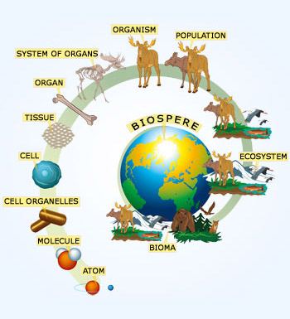
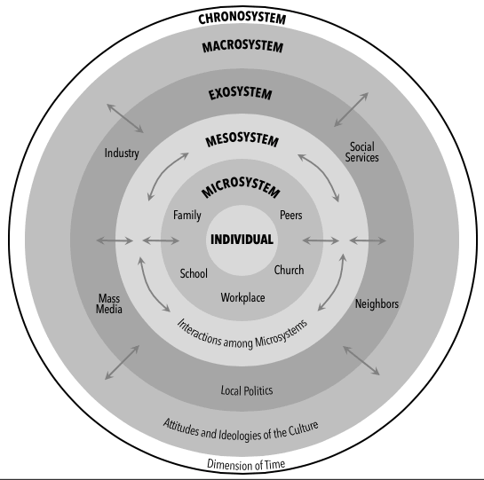
New sciences interact
https://www.thinglink.com/scene/744669743746646017
https://www.nikon.com/company/corporate/sp/universcale/

Slide 9
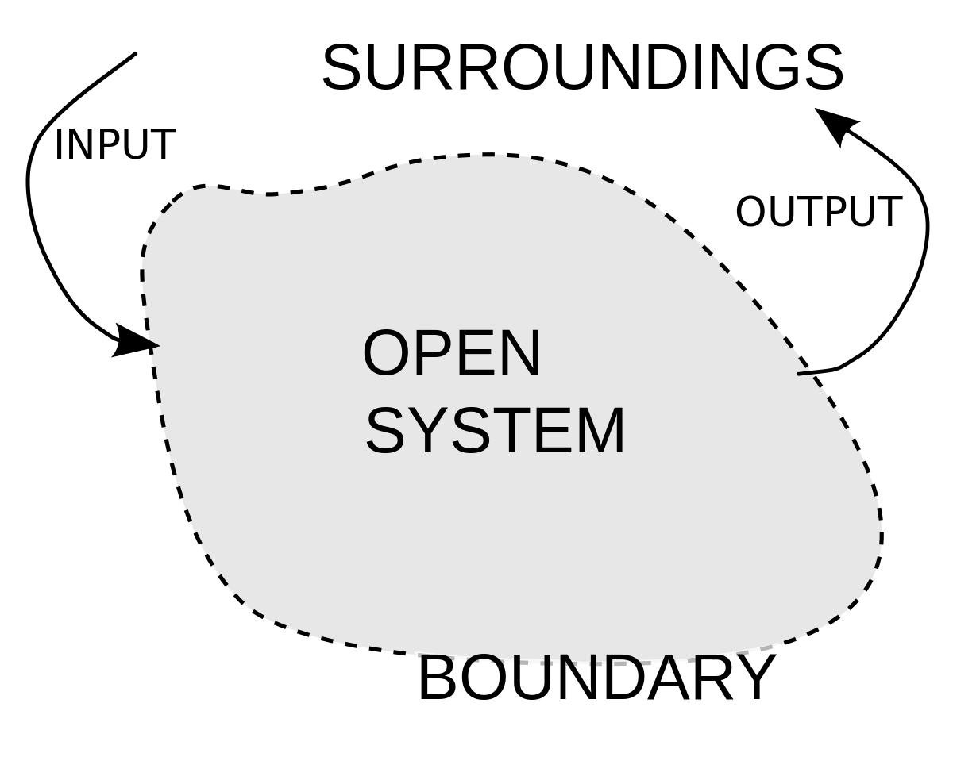
Systems thinking
Observer
The difference between the observer and the observed is eliminated
Relationships
Observed

Slide 10
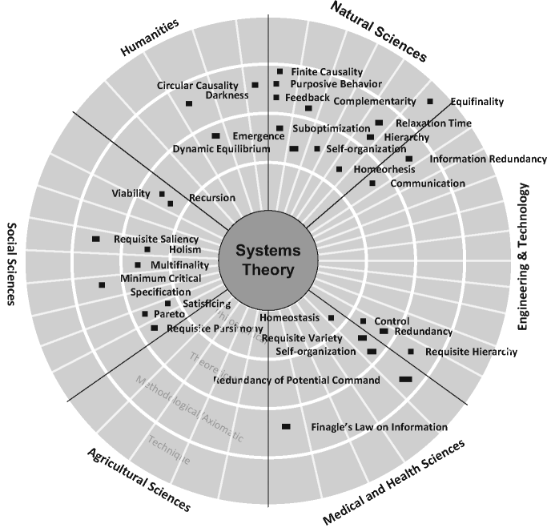
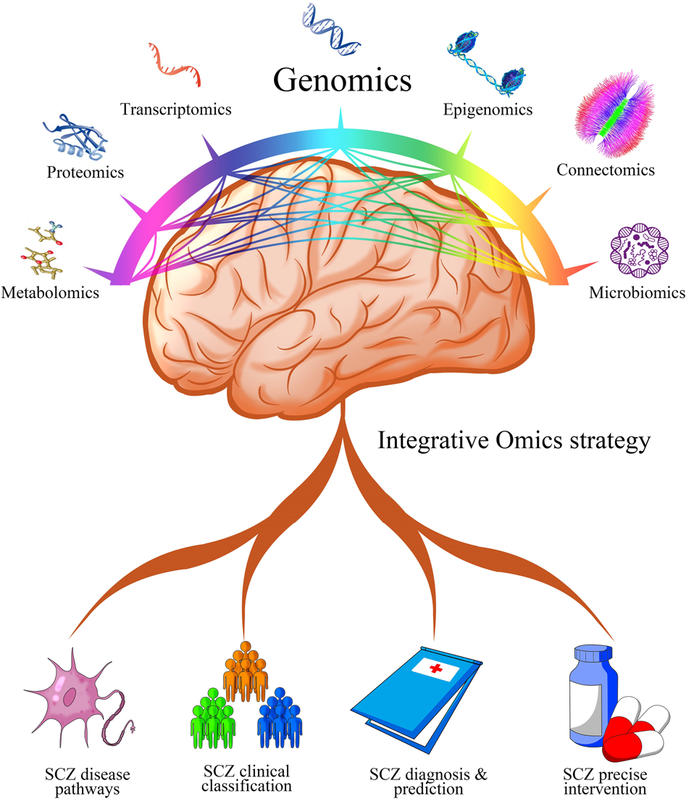

Slide 11
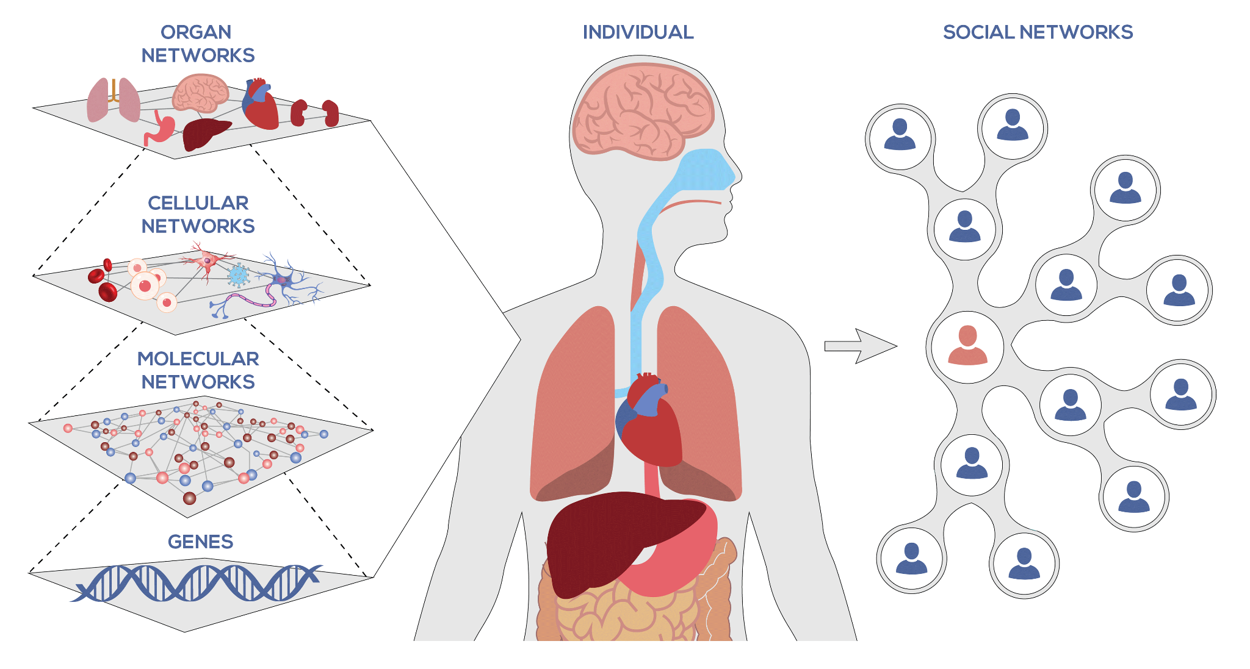

Slide 12
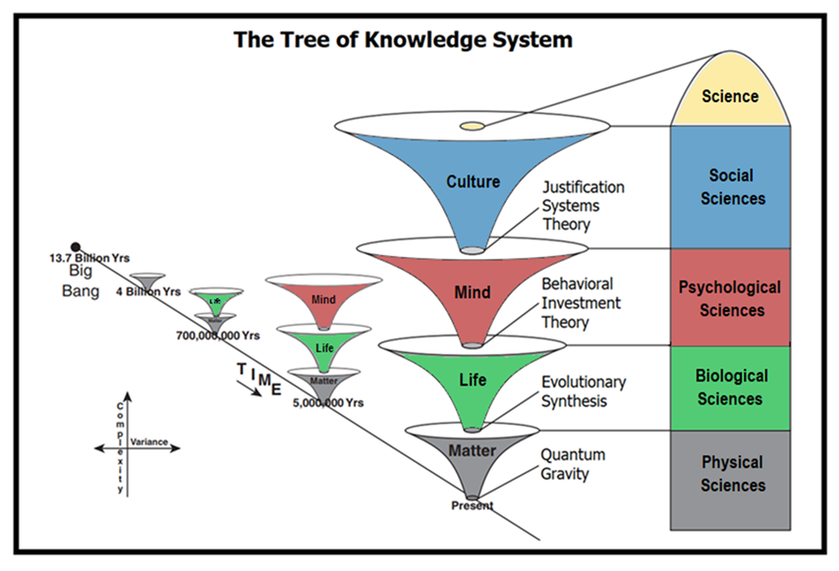
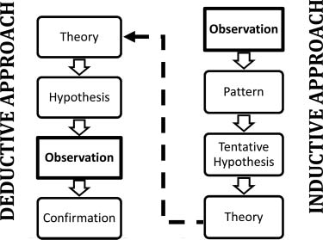
https://en.wikipedia.org/wiki/Tree_of_knowledge_system
Big history

Slide 13
Complex Systems
Any system that is composed of interactive components is a complex system
Examples: cells, organisms, brain
Simple rules can generate complex systems e.g. game of life
Rule - a cell can survive if there are cells next to it
Game of life, example
https://conwaylife.com/
https://www.youtube.com/watch?v=S-W0NX97DB0

Slide 14
Practical 0_2: Make ready github, first push-pull
Reference tutorial: https://www.youtube.com/watch?v=yxvqLBHZfXk
- Steps:
Make github, if already then skip
Make repository zero_{your_name}_assignments

Slide 15
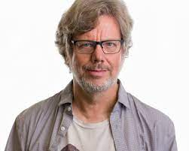
House of the Python
First of his name, Guido Von Rossum
Everything else we will discuss in upcoming classes.

Slide 16
Practical 0_3: Make ready sources
Stack_overfloating: https://youtu.be/v2BOctFvUT4 [1]
HPC carpentries: https://www.hpc-carpentry.org/hpc-python/
Rosalinda: https://rosalind.info/problems/list-view/?location=python-village
Kaggle: https://www.kaggle.com/datasets
-> Let’s do a crash course

Slide 17
Assignment 1
Do this, and put it in github assignment 1 [you should be able to execute the code]
https://www.kaggle.com/code/bhuvanchennoju/ancient-roots-of-agriculture-a-data-overview/
OR
https://www.bloomtech.com/article/programmer-analysts-vs-software-engineers-what-differentiates-them
Write a summary and put it into the assignment 1 folder.

